Slide 1
STEM Art Education Movement
A creative approach to education for innovation in the 21st Century by Jane Crayton
ARTE500
History and Philosophy of Art Education
Dr. Nancy Pauly

Slide 2
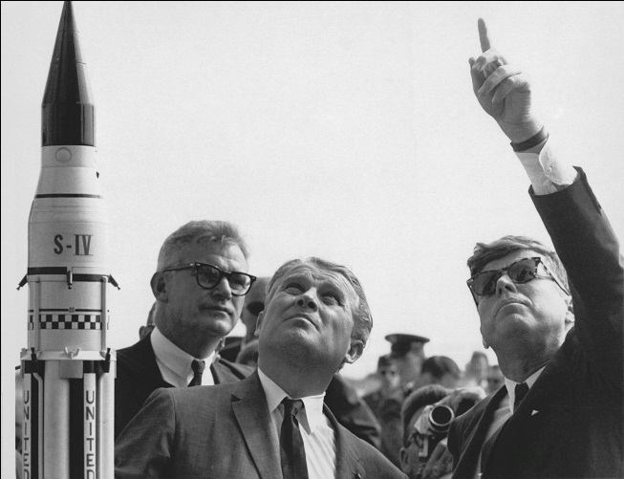

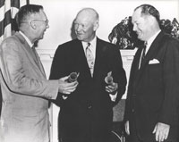
Abstract
The science, technology, engineering and math (STEM) movement has roots back to Dwight D. Eisenhower, and the formation of NASA and NSF in 1958. The STEM Art movement is a response, collage, and remix of previous Art Education theories and STEM Education concepts developed since that time.
The STEM Art movement seeks to inspire youth with multi-modal skills to stimulate the next generation of innovators and global citizens. In this paper, I seek to draw a model of evolution in innovative education promoted by governments, corporations and ultimately American pride.
Notes:
Dr. Wernher von Braun explains the Saturn Launch System to President John F. Kennedy. NASA Deputy Administrator Robert Seamans is to the left of von Braun.

Slide 3

Abstract Continued
However there are several concerns which ‘face the nation’ in 2011 in the wake of “No child left behind” act.
During the 21st century, a new kind of social ethics confronts educators in the classroom as they teach STEM subjects to technically savvy students. With increased population, saturation (technology) overload, climate change and globalization; teaching innovation to youth needs to be done with great care for social, environmental and technology ethics.
The inclusion of Multi-cultural STEM Arts Education creates opportunities for students to expand alternative, immersive, and multi-modal comprehension while exploring arts and humanities; integrating whole child
education philosophies.

Slide 4
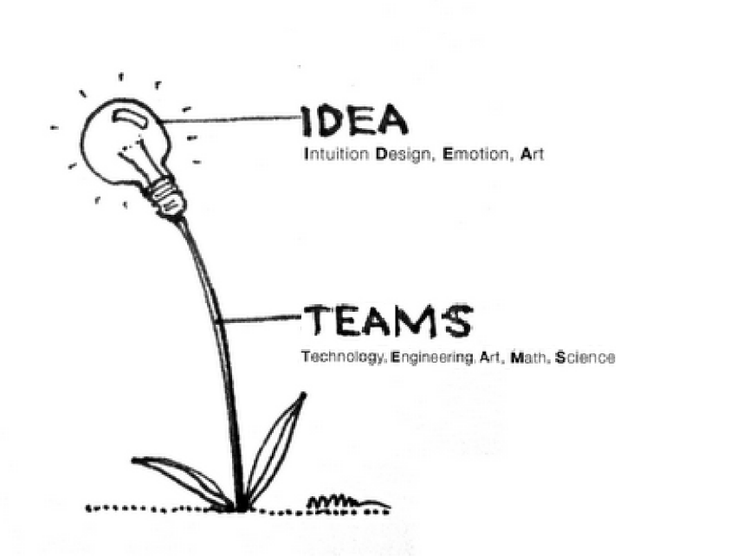
History of STEM Education
The term STEM was coined by Dr. Judith Ramaley when she was assistant director of the Education and Human Resources Directorate at the National Science Foundation (NSF) from 2001 to 2004. (Chute, 2009, p2)
From 2003 – 2005 I worked at the Laboratory for Atmospheric and Space Physics (LASP) in Educational Public Outreach as a Digital Media Specialist. Here I learned to collaborate with Scientists, Engineers, and Technology developers to create educational, promotional, and informative media for the lab.
Link to SDC cleanroom video:
http://janedapain.net/sdc.htm
Notes:
The term STEM education (for science, technology, engineering and mathematics) was coined by Dr. Judith Ramaley when she was assistant director at the National Science Foundation from 2001 to 2004. Ramaley’s concept of STEM situates learning in the context of solving real world problems or creating new opportunities—pursuit of innovation. Spurred by a public and private sector push for global competitiveness, STEM has become a lightning rod for education in 2010.

Slide 5
21st century challenge: STEM Education vs. Saturation overload
Since the 1990’s, we have fallen behind in exporting technology; now America is the leading consumer, not developer of technology products, and recent reports show us losing the race for generating income through development of innovative technologies.
  In broader terms, the US share of global exports has fallen in the past 20 years from 30% to 17%, while the share for emerging countries in Asia grew from 7% to 27%. The United States now has a negative trade balance even for high-technology products. That deficit raises concern about our competitive ability in important areas of technology. (Gathering Storm)
Increased use of technology by teens….
Decreased STEM majors by
undergraduate students.
Notes:
"Investing in the right scientists and the right technologies can improve the human condition quite dramatically." According to Bill Gates
Dr. Schiavelli suggests in his essay Innovation stems from scientifically educated workforce.
“STEM is now, and will increasingly be, the universal languages of the global marketplace. The
nations that invest heavily in STEM education, research and the development of a skilled
workforce will enjoy leadership positions. American students, however, are falling behind in the
essential subjects of math and science, putting our position in the global economy at risk.”

Slide 6
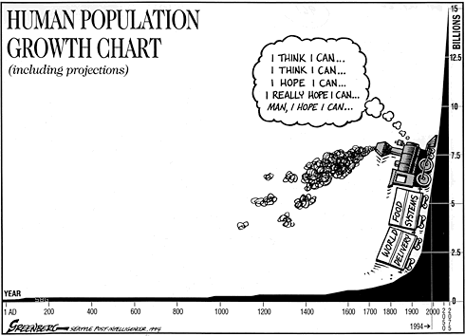
21st century challenge: Population, Environment and Globalization
Growing youth population
Increased impacts to environment
Connectivity and networked youth
Sweeny (2004) analyzes how contemporary digital technologies change societies. He raises questions about how art education can address challenges posed by the digital visual culture world that involves simulation, unique forms of interaction and new forms of visuality.”

Slide 7

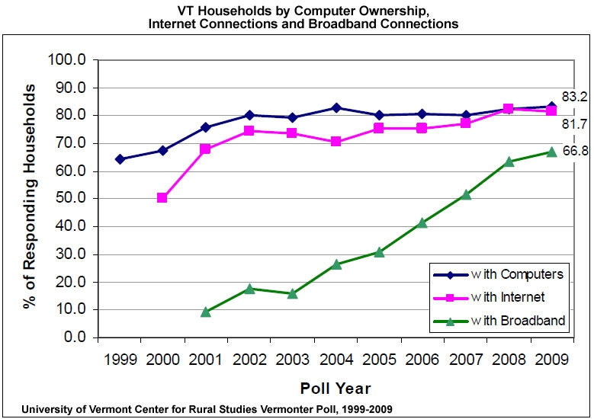
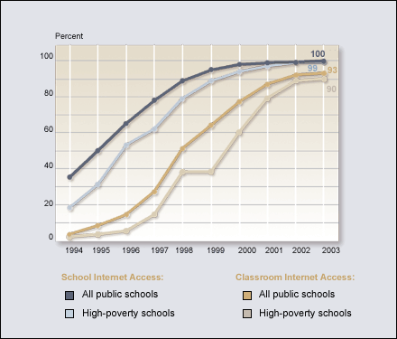
21st century challenge: Saturation Overload and the ethical technologist
Saturation overload: Attention Deficit Trait (ADT)
  Mass media
  Internet
  Information, sources and ethics
  Safety,
Notes:
“Attention Deficit Trait (ADT) is this over stimulation and saturation which
eventually creates this ADD like condition, where the’multi-tasker’ is overwhelmed, and
distracted by technology and all its nuances,” As defined by wikipedia.

Slide 8
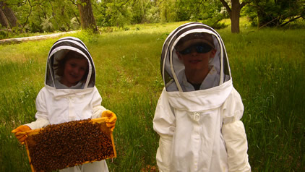
STEM Art Education includes several other education theories
Science, Technology, Engineering and Math (STEM)
Visual Culture Art Education (VCAE)
Discipline Based Art Education (DBAE)
Inquiry Based Education
Cyber Education
Immersive Education (iED)

Slide 9
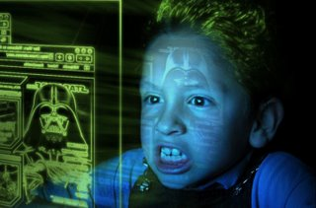
Cyber, Electronic and Digital Arts Education
Define cyber: A prefix that means "computer" or "computer network," as in cyberspace, the electronic medium in which online communication takes place.
Cyber, electronic, & digital arts: refers to the class of art produced with the help of computer software and hardware; often with an interactive or multimedia aspect. Online, networked, and electronic and digital in form and content.
Example: Digital narrative blogging,
gaming, networking.
http://digiru.com/ipd/
“To communicate with these students, educators
must acquaint themselves with electronic products.” (Wang)
Notes:
Moreover, research has shown that the development of technology and advanced devices has strongly motivated the students to learn art.” (e.g., Boughton & Wang, 2002; Dorn, Madeja, & Sabol, 2004; Freedman, 2003; Wang 2004).

Slide 10
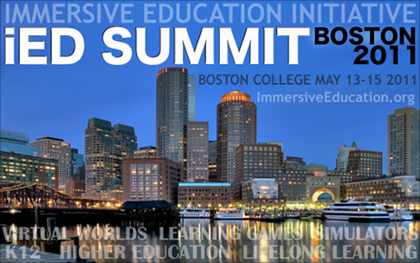
Immersive education (iED)
Define immersive: An immersive digital environment is an artificial, interactive, computer-created scene or "world" within which a user can immerse themselves.
Immersive Education included lessons in
To create a sense of full immersion, the 5 senses (sight, sound, touch, smell, taste) must perceive the digital environment to be physically real. Immersive technology can perceptually fool the senses through:
Panoramic 3D displays (visual)
Surround sound acoustics (auditory)
Haptics and force feedback (tactile)
Smell replication (olfactory)
Taste replication (gustation)
Example: Immersive Landscapes Class
Grid Summit: Immersive Education (iED)

Slide 11
Benefits to STEM Arts Integration
Creative behavior
Inventive development skills
Critical thinking
Constructivist learning (Web 2.0, social + learning)
Ethics
Aesthetics
Techniques
Style
Practice
STEM + ART = MATTERS!

Slide 12

Current STEM Arts programs and philosophies in the United States
Science, Technology, Engineering, Arts and Math (STEAM)
Technology, Engineering, Arts, Math and Science (TEAMS)
STEM+Arts: Creating hybrids: disovling boundaries between Art, Science and Technology.
Science, Technology, Engineering and Math thru Art (STEM-A) mission is to expand STEM education through arts immersion. Our goal is to spark life-long passions in STEM subjects, fostering sustainable future for STEM education, career and community development.
Art STEM (teaching and learning at the intersection of the arts and STEM disciplines.

Slide 13
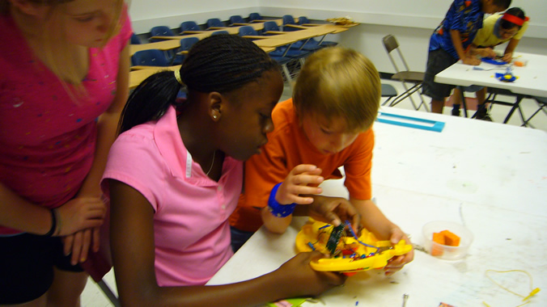
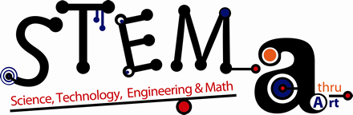
Evolution into STEM thru Art Education
Define STEM Arts Education
Inquiry of STEM subjects through arts immersion.
Example:
  Secrets of the Hive (Beekeeping)
  Circuit Bending
  Immersive Landscapes
  E-Instrumental

Slide 14
Bibliography
Brazell, J. (2010). Connecting STEM and Arts (TEAMS) to Spur U.S. Innovation: Part 1 of 5. Retrieved from http://www.jimbrazell.com/ahead-of-the-curve/2011/1/31/connecting-stem-and-arts-teams-to-spur-us-innovation-part-1.html
Chapman, L. (1978). A perspective on art education Approaches to Art Education (pp. 4-21). New York: Harcourt Brace Jonanovich.
Lowenfeild, V. (Ed.). (1975). Creative and Mental Growth (6 ed.). New York: Macmillan.
McFee, J. K. (1998). Cultural diversity and the structure and practice of art education. Paper presented at the National Art Education Association, Reston, VA.
Platz, J. (2008). How Do You Turn STEM Into STEAM? Add the Arts! Triad(January/February), 19-24.
Reaching Students Through STEM and the Arts. (January 2010). NSTA Reports! Monthly Newspaper of the National Science Teachers Association, 21(5), Cover, 2.
Smith, L. (2009). The National Art Education Association Conference: Recharging Inspiration for Art Education. Scope (The Newsletter of the Art Education Program at The University of Texas at Austin) Retrieved Spring/Summer 2009, from http://www.finearts.utexas.edu/aah/files/Scope_newsletter/Scope_SpringSummer_2009.pdf
Wang, S.-C. (Ed.). Digital Journals: The Past, Present, and Future of Electronic Portfolios for Visual Culture Learners.

